Slide 1

AOLME Curriculum SESSION 7
MATERIALS DEVELOPED BY THE AOLME PROJECT AT THE UNIVERSITY OF NEW MEXICO, PLEASE DO NOT COPY OR DISTRIBUTE ANY OF THESE COPYRIGHTED TASKS WITHOUT PROPER AUTHORIZATION

Slide 2


Level 1
SESSION 1: Basic of Raspberry PI and Linux-(motivational overview of projects-images, ls, cd) SESSION 2: Introduction to Python Programming (print, algebra, strings) SESSION 3: Algorithms: Loops, Conditionals, and Sequential Thinking (for and while loops, range commands, if statements, inequalities, sprite movement) SESSION 4: The Coordinate Plane and Black & White Images in Python SESSION 5: Binary and Hexadecimal number systems SESSION 6: Images and Their Components (histograms) SESSION 7: Creation of Images and Video FINAL PROJECT: VIDEO

Slide 3
Creation of images and videos
OBJECTIVES:
Introduce students to working with multiple frames using Numerical Python Arrays.
Understand how to combine frames to create a video.
Understand how to create a video project.

Slide 4

Selected ACTIVITIES
1. Working with two frames
2. Create a video
3. Open a project from Level I and discuss

Slide 5


7.1. Working With Two Frames
Access jupyter notebook through the terminal: by typing in it: jupyter notebook, click enter and navigate the raspberry directory system as follows: /home/pi/AOLME/Session7/
Then open the file named: NumPyArrays
2. Run & Analyze: Run PixelEx.py, Row.Ex.py, im_fill
using
r = "ff0000"
start_row = 1
end_row = 2
start_col = 0
end_col = 1
im_fill (frame_1, [start_row, end_row], [start_col, end_col], r)
Study the im_fill() command.
Once in this file, note that there are ACTIVITIES: A, B, C, and D.
What differences do you notice between CELLS C and D?
Use comments in the CELLs as a guide.
3. Think & Create: Now it’s your time to show what you’ve learned. Experiment with the cells.
4. Discuss & Write: Based on the tasks you’ve done, discuss in your team:
How do you change a single pixel?
How do you change a row of pixels?
How do you change a block of pixels?
Write down in your journal what you’ve learned?
AOLME PROJECT - LEVEL 1- SESSION 7- 2018
MATERIALS DEVELOPED BY THE AOLME PROJECT AT THE UNIVERSITY OF NEW MEXICO, PLEASE DO NOT COPY OR DISTRIBUTE ANY OF THESE COPYRIGHTED TASKS WITHOUT PROPER AUTHORIZATION

Slide 6

7.1. Working With Two Frames
Resources for the Activity
Recommended Steps for the Activity
Activity Card
Folder: /home/pi/AOLME/Session7/
the “jupyter” notebook accessed via Terminal
Raspberry Pi and Monitor
Student journal
Make sure that students use own words to define single pixels, rows of pixels, or block of pixels.
Have students work with different cells and compare the code across.
When playing with numbers have students come up with their own examples too.
Have students debrief what they learned by experimenting and have them write notes in journal.
Everyone in the team gets to play a role:
Discussion Expert: Leads the team discussion asking questions about what the session is about.
Fair Participation Expert: makes sure of fair participation of everyone.
Hardware Setup/Teardown Expert: in charge of setting up & putting away materials and computer equipment.
Summary Expert: summarizes and records team questions and what the teams has learned.
Activity 1 Goal: Introduce students to arrays and frames and how to make changes from frame to frame.
AOLME PROJECT - LEVEL 1- SESSION 7- 2018
MATERIALS DEVELOPED BY THE AOLME PROJECT AT THE UNIVERSITY OF NEW MEXICO, PLEASE DO NOT COPY OR DISTRIBUTE ANY OF THESE COPYRIGHTED TASKS WITHOUT PROPER AUTHORIZATION

Slide 7
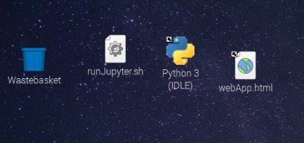
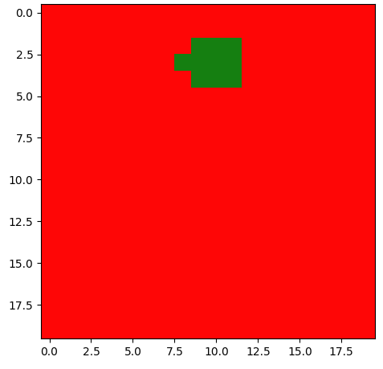
7.2. Create a Video
Python IDLE. Open IDLE and navigate the
directory to /home/pi/AOLME/Session7/.
Then run videoDemo.py
2. Analyze and modify: Find the following code and discuss what it does. How does it work?
move_r = 2
for row in range(rows):
for col in range(cols-move_r):
frame2[row][col+move_r]=frame1[row][col]
Go through the code and discuss the code that produces the other 3 movements. Modify the code!
3. Think & Program: Below is the code to play a list of 5 video frames.
4. Write: The team and summary expert will discuss what you learned in this session.
frame_list = [frame1, frame2, frame3, frame4, frame5]
fps= 2 # Number of frames per second
play_video= vid_show(frame_list, fps)
Last line plays the video.
Note that fps = frames per second.
Modify the fps to make the video play faster or slower.
AOLME PROJECT - LEVEL 1- SESSION 7- 2018
MATERIALS DEVELOPED BY THE AOLME PROJECT AT THE UNIVERSITY OF NEW MEXICO, PLEASE DO NOT COPY OR DISTRIBUTE ANY OF THESE COPYRIGHTED TASKS WITHOUT PROPER AUTHORIZATION

Slide 8
7.2. Create a Video
Resources for the Activity
Recommended steps for the Activity
Make sure students ‘play’ with the code
Let students copy and paste codes for the moves. The goal is to think with the code.
Try not to tell them, instead ask questions to prompt their thinking.
Activity Card
Folder: /home/pi/AOLME/Session 7/ and file: videoDemo.py
2. Raspberry Pi kit
3. Student journal
Evaluate how did the team roles work?
Discussion Expert: Leads the team discussion asking questions about what the session is about.
Fair Participation Expert: makes sure of fair participation of everyone.
Hardware Setup/Teardown Expert: in charge of setting up & putting away materials and computer equipment.
Summary Expert: summarizes and records team questions and what the teams has learned.
Activity 2 Goal: Practice pseudocodes through sequential thinking.
AOLME PROJECT - LEVEL 1- SESSION 7- 2018
MATERIALS DEVELOPED BY THE AOLME PROJECT AT THE UNIVERSITY OF NEW MEXICO, PLEASE DO NOT COPY OR DISTRIBUTE ANY OF THESE COPYRIGHTED TASKS WITHOUT PROPER AUTHORIZATION

Slide 9
7.3. Discuss Level 1 Projects
Python IDLE. Open IDLE and navigate the
directory to /home/pi/AOLME/Session7/.
Then select a folder from a school and a
project to run. Run different projects.
2. Analyze: Let the facilitator discuss their project.
Go through the code and discuss the code with the rest of the group. Modify the code!
3. Replay: Find the commands vid_show(), frame_list, and fps and modify them.
4. Write: The team and summary expert will discuss what you learned in this session.
Which ideas do you want to implement in your project?
AOLME PROJECT - LEVEL 1- SESSION 7- 2018
MATERIALS DEVELOPED BY THE AOLME PROJECT AT THE UNIVERSITY OF NEW MEXICO, PLEASE DO NOT COPY OR DISTRIBUTE ANY OF THESE COPYRIGHTED TASKS WITHOUT PROPER AUTHORIZATION

Slide 10
7.3. Discuss Level 1 Projects
Resources for the Activity
Recommended steps for the Activity
Make sure students ‘play’ with the code
Make sure co-facilitator discusses their code
Let the students ask questions about the project that the co-facilitator worked on. Try not to tell them, instead ask questions to prompt their thinking.
Have students debrief and write about what they learned in session 7.
Activity Card
Folder: /home/pi/AOLME/Session7/ and projects under this directory.
2. Raspberry Pi kit
3. Student journal
Evaluate how did the team roles work?
Discussion Expert: Leads the team discussion asking questions about what the session is about.
Fair Participation Expert: makes sure of fair participation of everyone.
Hardware Setup/Teardown Expert: in charge of setting up & putting away materials and computer equipment.
Summary Expert: summarizes and records team questions and what the teams has learned.
Activity 2 Goal: Practice pseudocodes through sequential thinking.
AOLME PROJECT - LEVEL 1- SESSION 7- 2018
MATERIALS DEVELOPED BY THE AOLME PROJECT AT THE UNIVERSITY OF NEW MEXICO, PLEASE DO NOT COPY OR DISTRIBUTE ANY OF THESE COPYRIGHTED TASKS WITHOUT PROPER AUTHORIZATION

